Slide 1
Introduction to Deep Learning: Algorithms and Their Applications
CDC Short Course
Xiaoming Huo, Georgia Tech

Slide 2
Schedule
8:30-9:30 Module 1: Introduction
9:45-10:45 Module 2: Overview & preparation
11:00-12:00 Module 3: Neural networks - basics
12:00-1:15 Lunch break
1:15-2:00 Module 4: Neural networks - models
2:15-3:00 Module 5: Convolutional neural networks
3:15-4:00 Module 6: Some examples
4:00 Adjourn
Online resources: https://github.com/xhuo17/CDC_DL_2022

Slide 3
Basic Component in Neural Networks: Perceptron

Slide 4
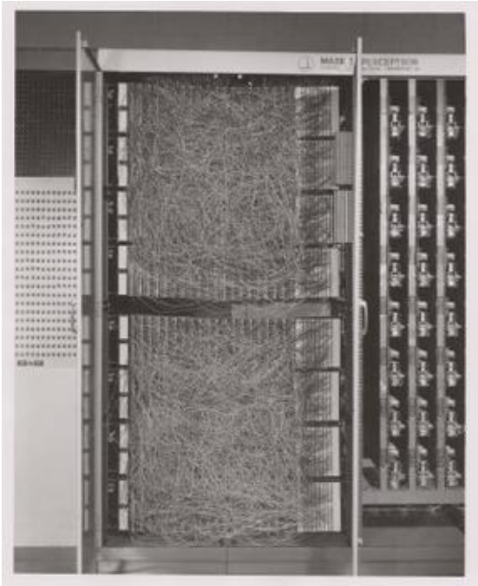
Perceptron
Mark I Perceptron, 1960 (wikipedia.org)

Slide 5
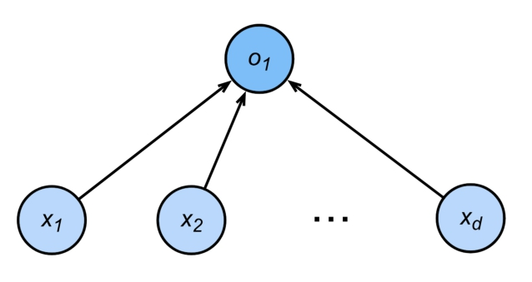
Perceptron
•

Slide 6
Perceptron
• Given input
x
, weight
w
and bias
b
, perceptron outputs:
• Binary classification (0 or 1)
• Vs. scalar real value for regression
• Vs. probabilities for logistic regression

Slide 7
Perceptron
Ham
Spam

Slide 8
Training the Perceptron

Slide 9
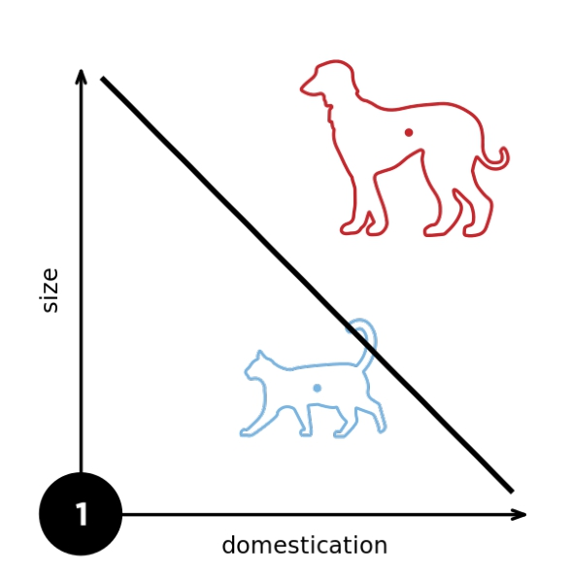
From wikipedia

Slide 10
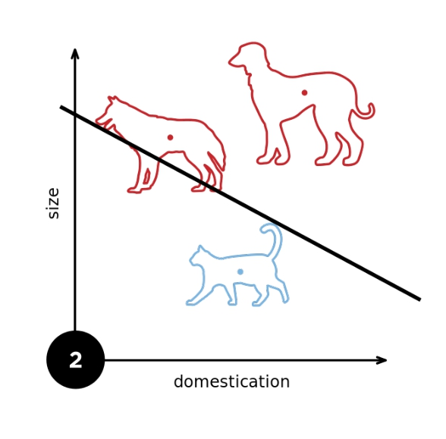
From wikipedia

Slide 11
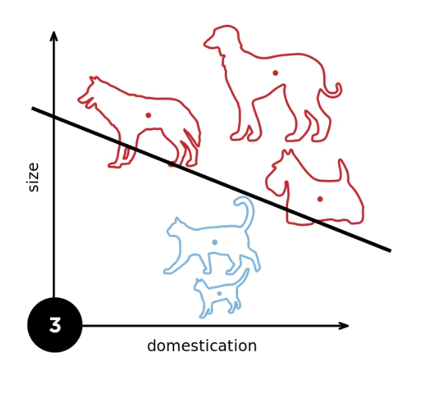
From wikipedia

Slide 12
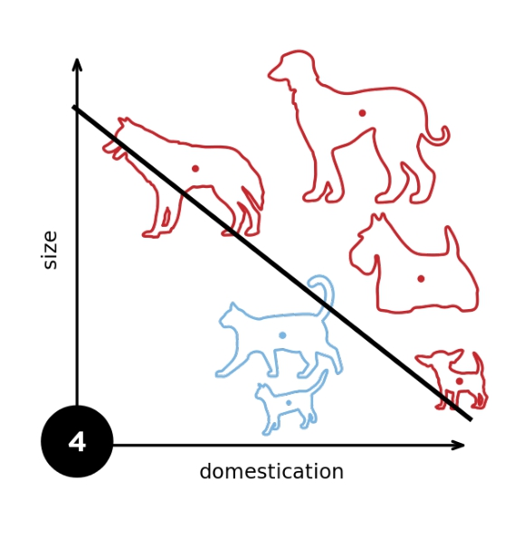
From wikipedia

Slide 13
Convergence Theorem
• Radius r enclosing the data
• Margin ρ separating the classes
for
• Guaranteed that perceptron will
converge after
steps

Slide 14

Consequences
• Only need to store errors. This gives a compression bound for perceptron.
• Fails with noisy data
do NOT train your avatar with perceptrons
Black & White

Slide 15
XOR Problem (Minsky & Papert, 1969)
The perceptron cannot learn an XOR function (neurons can only generate linear separators)

Slide 16
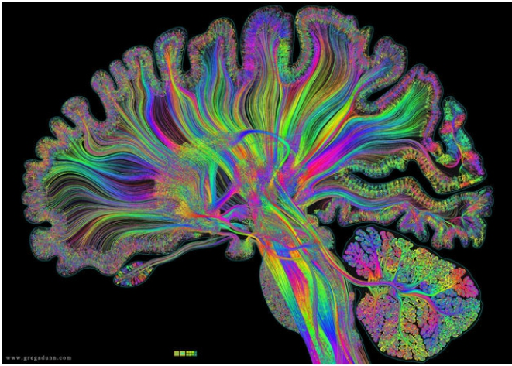
Multilayer
Perceptron

Slide 17
Learning XOR
1 2
3 4

Slide 18
Learning XOR
1 2 3 4
+ - + -
+
+
+
-
-
-
-
+
product
1
3
2
4

Slide 19





Learning XOR
1 2 3 4
+ - + -
+
+
+
-
-
-
-
+
product
1
3
2
4

Slide 20
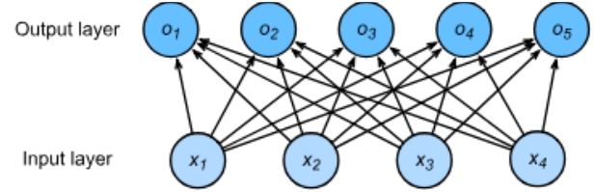
Single Hidden Layer

Slide 21
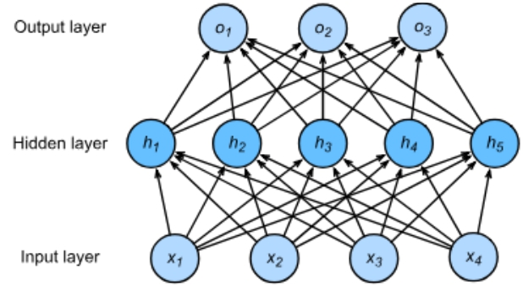
Single Hidden Layer
Hyperparameter - size m of hidden layer

Slide 22

Single Hidden Layer
σ
is an element-wise activation function

Slide 23
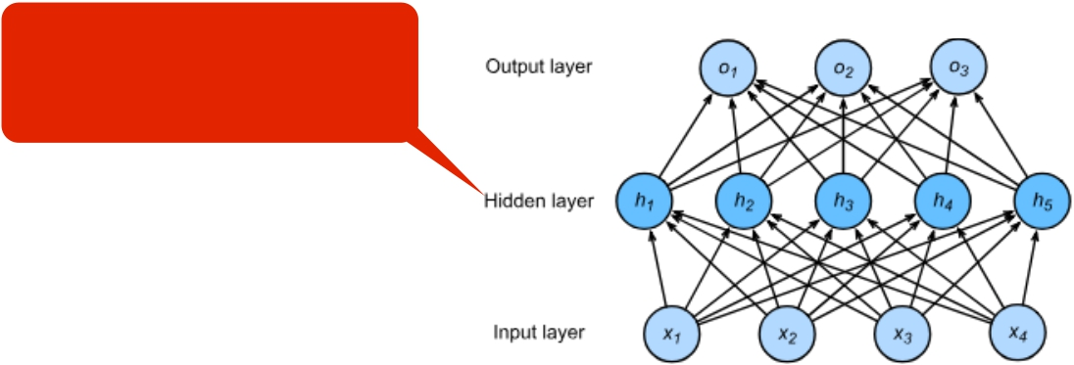
Single Hidden Layer
Why do we need an a
nonlinear activation?
σ
is an element-wise activation function

Slide 24
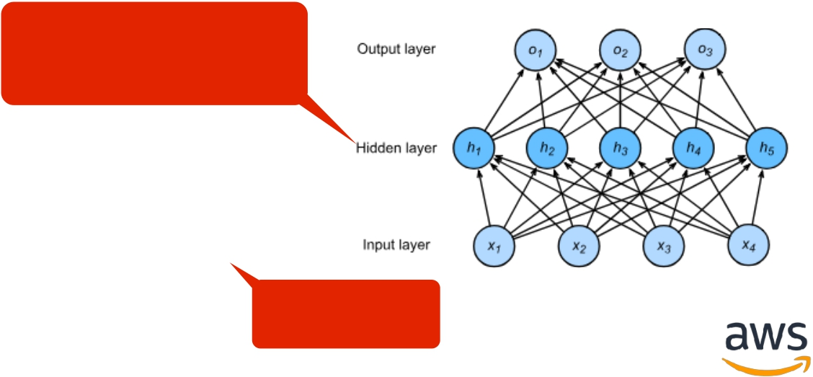
Single Hidden Layer
Why do we need an a
nonlinear activation?
Linear …

Slide 25
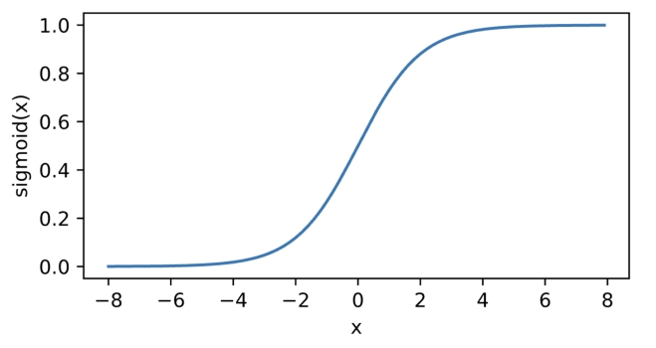
Sigmoid Activation
Map input into (0, 1), a soft version of
1
sigmoid(x) =
1 + exp(−x)

Slide 26
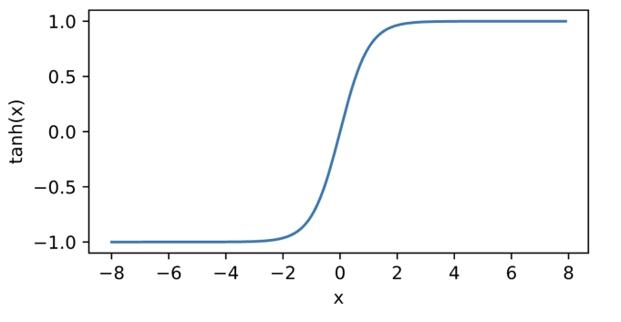
Tanh Activation
Map inputs into (-1, 1)
tanh(x) = 1 − exp(−2x)
1 + exp(−2x)

Slide 27
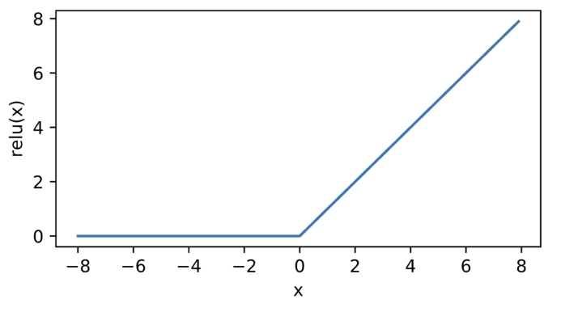
ReLU Activation
ReLU: rectified linear unit
ReLU(x) = max(x,0)

Slide 28

Multiclass Classification

Slide 29
Multiclass Classification

Slide 30
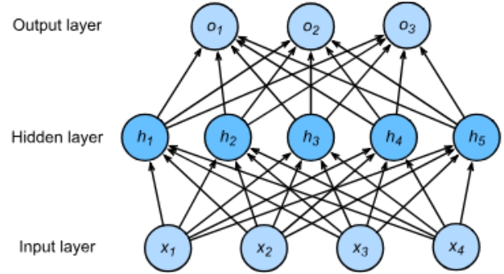
Multiclass Classification
• Hidden
• Output

Slide 31
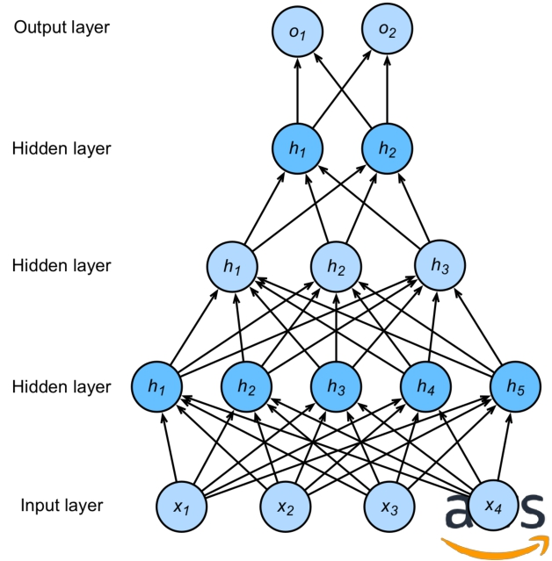
Multiple Hidden Layers
Hyper-parameters
• # of hidden layers
• Hidden size for each layer

Slide 32
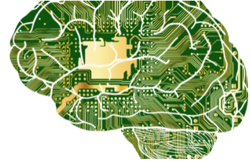
Hardware for Deep Learning
(articleshub360.com)

Slide 33

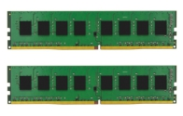
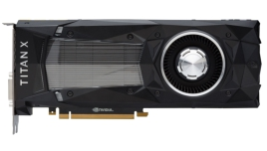
Your GPU Computer
Intel i7
0.15 TFLOPS
DDR4
32 GB
Nvidia Titan X
12 TFLOPS
16 GB

Slide 34
Improve CPU Utilization I
• Before computing a + b, need to prepare data first
• Main memory -> L3 -> L2 -> L1 -> registers
• L1 cache reference time: 0.5 ns
• L2 cache reference time 7 ns (14 x L1)
• Main memory reference time 100ns (200 x L1)
• Improve temporal and spatial memory locality
• Temporal: reuse data so we keep them on cache
• Spatial: read data sequential so we can pre-fetch data

Slide 35

Case Study
• For a matrix stored in raw-major, accessing a column is
slower than accessing a row
• CPU reads 64 bytes (cache line) each time
• CPU “smartly” reads the next cache line ahead when
it’s needed

Slide 36
Improve GPU Utilization
• Parallelization
• Uses thousands of threads
• Memory locality
• Simple cache architecture and small cache size
• Simple control flows
• Very limited support
• Large synchronization

Slide 37

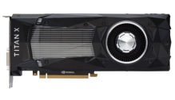

CPU vs GPU
# Cores
6 / 64
2K / 4K
TFLOPS 0.2 / 1 10 / 100
Memory size 32 GB / 1 TB 16 GB / 32 GB
Memory
bandwidth
30 GB/s / 100 GB/s 400 GB/s / 1 TB/s
Control flow Strong Weak
Typical / High End

Slide 38

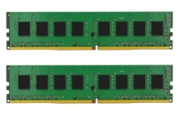
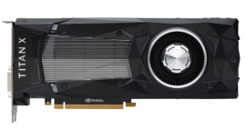
CPU/GPU Bandwidth
30 GB/s
PCIe 3.0 16x: 16 GB/s
480 GB/s
• Do not copy data between GPU and CPU frequently
• Limited PCIe
bandwidth
• Synchronization
overhead
PCIe: Peripheral Component Interconnect Express

Slide 39
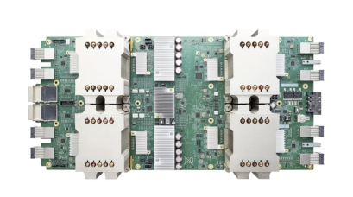
More Promising Hardware

Slide 40
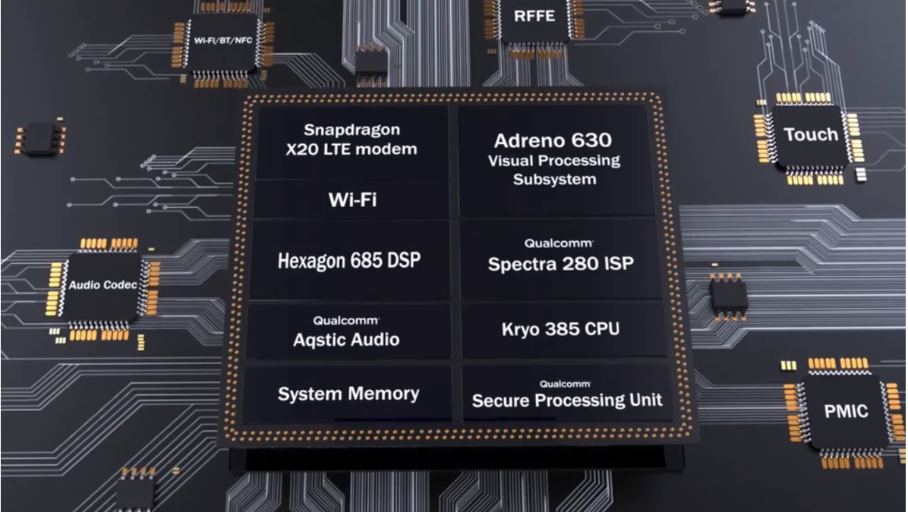
Qualcomm Snapdragon 845

Slide 41
Systolic Array
• An array of processing elements (PE)
• Good at performing matrix-matrix multiplication
• Relative easy/cheaper to build
PE PE PE
PE PE PE
PE PE PE
Input
Output

Slide 42
Matrix Multiplication with Systolic Array
Time 0 Y = WX
x12 x11 w11 w21 w31 3x2 3x3 3x2
x22
x31
x21
0
0
0
w12
w13
w22
w23
w32
w33
x32

Slide 43

Matrix Multiplication with Systolic Array
Time 1 Y = WX
x12 x11w11 w21 w31 3x2 3x3 3x2
Move inputs to right
x32
w12
w13
w22
w23
w32
w33
x22
x31
x21
0

Slide 44


Matrix Multiplication with Systolic Array
Time 2
Move results
Y = WX
3x2 3x3 3x2
x12w11
x11w21
w31
to bottom
x32
Move inputs to right
x22
x31
x11w11+ x21w12
w13
w22
w23
w32
w33

Slide 45


Matrix Multiplication with Systolic Array
Time 3 Y = WX
x12w21
x21w22+ x11w21
x11w31
w32
3x2 3x3 3x2
Move inputs to right
x22w12+ x12w11
x31w13+
x32
x21w12+ x11w11
w23
w33
Move results to bottom

Slide 46
Matrix Multiplication with Systolic Array
Time 4 Y = WX
x12w31 3x2 3x3 3x2
x22w22+ x12w21
x21w22+ x11w31
x32w13+ x22w12+ x12w11
y11
x31w23+ x21w22+ x11w21
w33

Slide 47
Matrix Multiplication with Systolic Array
Time 5
Y = WX
3x2 3x3 3x2
x22w22+ x12w31
x31w23+ x21w22+ x11w21
x32w23+ x22w22+ x12w21
y12 y11
y21

Slide 48
Matrix Multiplication with Systolic Array
Time 6
Y = WX
3x2 3x3 3x2
x33w23+ x23w22+ x13w21
y22 y22
y12
y11
y21

Slide 49
Matrix Multiplication with Systolic Array
Time 7
Y = WX
3x2 3x3 3x2
y32
y22 y31
y12 y21

Slide 50
Systolic Array
• For general size matrix multiplication, slice and pad inputs
to match the SA size
• Batch inputs to reduce the latency cost
• ASIC has other dedicated components for other NN
operations, such as sigmoid

Slide 51
Packages

Slide 52
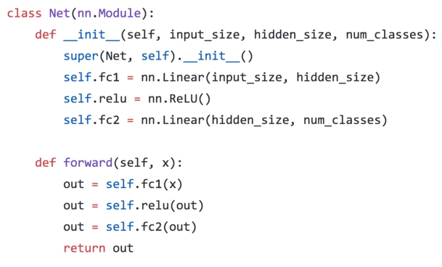
Pytorch
• Torch tensors + chainer neural networks
• Easy to develop and
debug
• Less convenient to
deploy

Slide 53
Software Demo
1model-construction.ipynb
2parameters.ipynb
3deferred-init.ipynb
4custom-layer.ipynb
5read-write.ipynb
6use-gpu.ipynb

